Slide 1
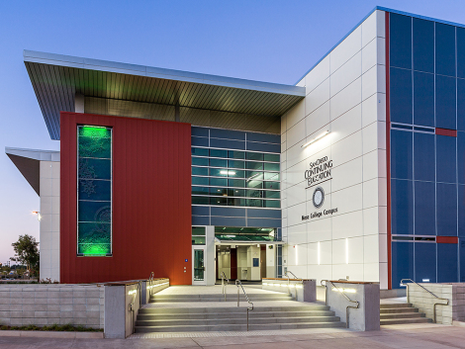
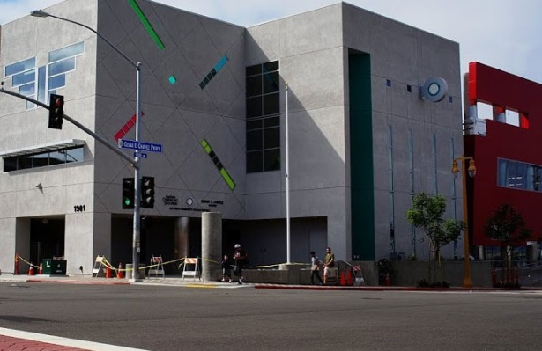
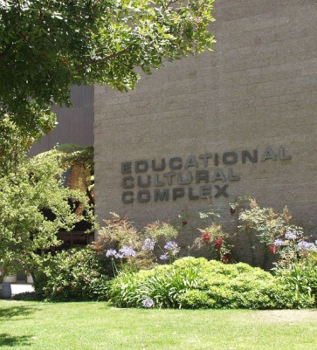
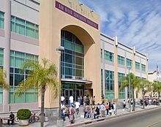
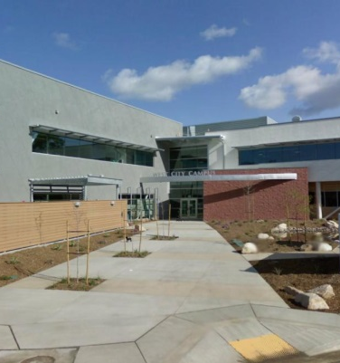
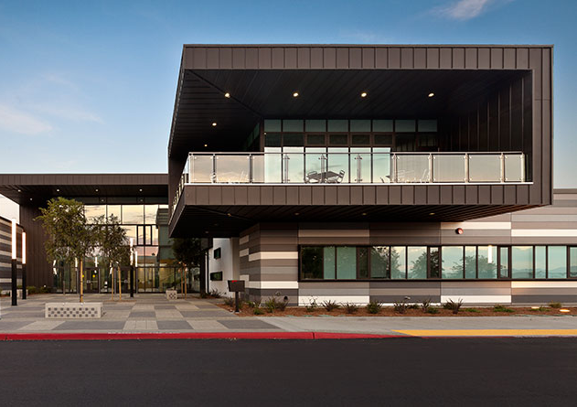
CE AT MESA COLLEGE | CESAR CHAVEZ | EDUCATIONAL CULTURAL COMPLEX | MIDCITY | WEST CITY | NORTH CITY |CE MIRAMAR

Slide 2
San Diego College of Continuing Education
A little bit about us:
Non-credit based career training programs
Within the San Diego Community College District
7 campuses throughout San Diego
FREE accessible programs and courses
Age requirement
Citizenship does not impact eligibility
Not income based

Slide 3
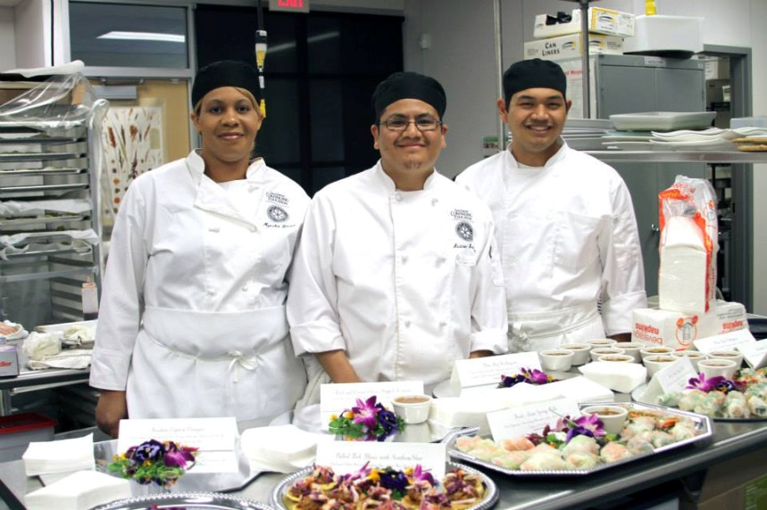
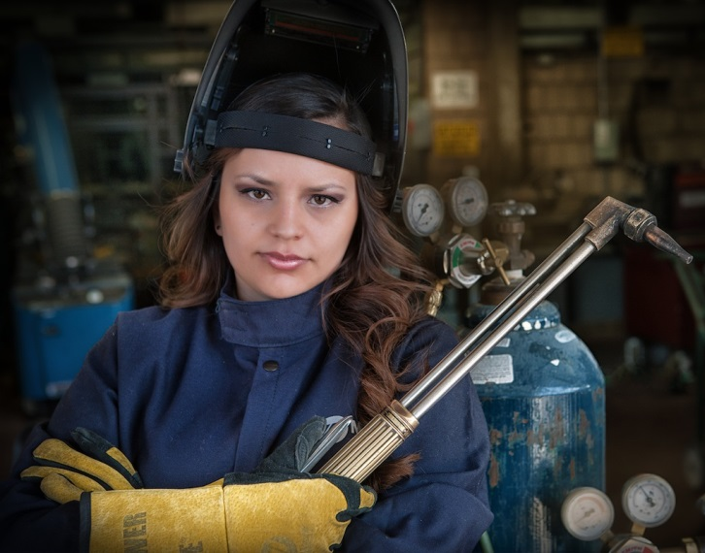
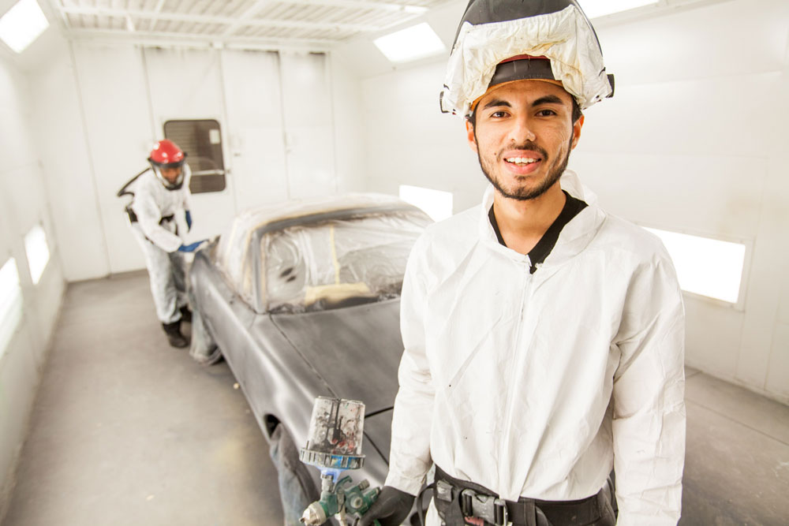
Certificate Programs
Over 70 FREE short-term (most one year or less) programs
Accounting/ Business
Digital Media
Child Development
Healthcare Careers
Automotive
Culinary Arts
Computers & Information Technology
Clothing and Textile Arts
Skilled and Technical Trades: Electronics, HVAC, Plumbing and Welding

Slide 4
High School Diploma/ Equivalency:
High School Diploma
High School Diploma Program—minimum of 24 high school credits to meet requirements for diploma completion
Orientation/assessment required
Transcripts required (transcript evaluation completed by counselor)
High School Equivalency
HiSET/GED preparation (available in Spanish and English)
Orientation/assessment required
Notes:
High School diploma, 6 weeks cohorts: Chavez & ECC
Assisted by tutors and IAs.
Meanwhile, they can do their senior exhibition, computer literacy.
TABE is for HSE (English) students only.
9 weeks classes (HSE)

Slide 5
Emeritus Program:
Specifically designed for adults 55+ years and helps students maintain independence, rejoin the workforce and be actively engaged in the community.
Art
Drama
Music
Law and the Retiree
Consumer Education
Nutrition, Health, and Wellness
Retirement
Social Studies
Notes:
Phone (619)-388-1980

Slide 6
ESL (English as Second Language)
General ESL courses: 7 levels from beginning to advanced
Integrated reading, writing, listening, speaking
Transition to college option for level 6-7
Workplace Communication + ESL
Resume building
Interview preparation
Work-related communication skills
Special Topic Classes
Conversation
Pronunciation
Citizenship
Reading
Grammar
Check out our website to enroll! :
SDCCE.EDU

Slide 7
Student Support Services
Counseling and Support Services
Disability Support Programs & Services (DSPS)
CalWORKS
Back to work Veteran Outreach Program (VOP)
PATHWAYS
San Diego Continuing Education Promise
Career Services
Technology Access Program (TAP)
Gateway to College and Career
Direct Aid Support

Slide 8
Disability Support Programs and Services (DSPS):
These Services are intended to assist students with disabilities to more successfully participate in DSPS and regular academic/vocational classes and programs
Registration assistance
Learning disability assessment
Counseling: academic, vocational and disability
Sign language interpreting
speech to text (STS)
Specialized equipment loan
Access technology
alternate media
specialized resource groups
campus liaison
NCR paper for note taking
community liaison
specialized classes
testing accommodations

Slide 9
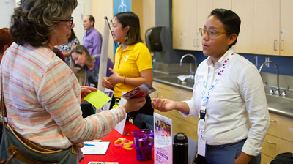
Career and College Transition Centers and Services:
Services for Students:
Job Search Working with job developers search for job openings, explore internships, learn about career events and workshops, participate in on-campus interviews, and have access to a directory of employers.
Job Fairs, Employer Mixers or Employer Spotlights We regularly host employer events that put you in direct contact with companies who are hiring.
Building Your Career Skills Get hands-on practice with interview techniques, crafting resumes, and making a great first impression on potential employers.
Transfer information Interested in advancing your knowledge and degree? Find out what you can to do prepare.
Career Counseling Career counselors are dedicated to helping you develop skills, explore a career or choose an educational program that will lead to a career.
Notes:
We will help you with:
Learning job search strategies
Writing, critiquing and revising resumes and cover letters
Learning and practicing interview skills, strategies and techniques
Finding and applying for full-time and part-time jobs
Networking with professionals in a field of interest
Transition to college
Be prepared to talk about your interests, skills, and abilities. The more you take stock of yourself, the easier it is to make a good career decision, create your resume and sell yourself in the interview to get the job you want. Whatever your goals, we're here to help you reach your full academic and professional potential. Visit the Career and Transition Centers to make an appointment.

Slide 10
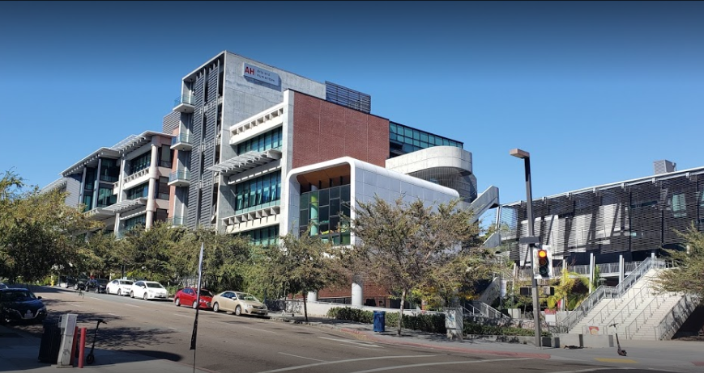
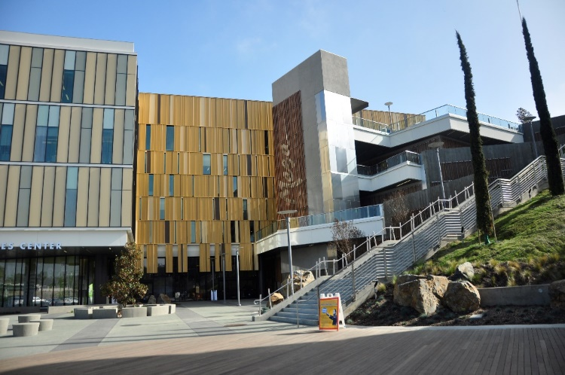
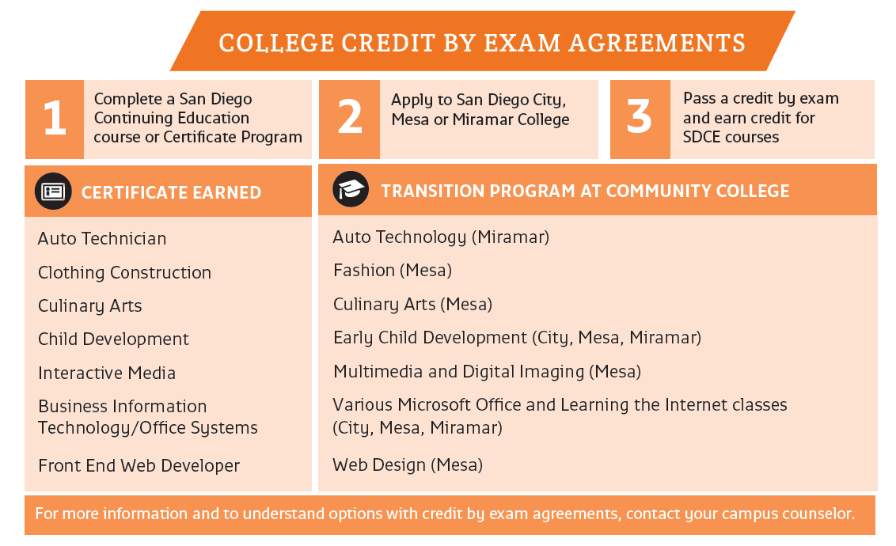
What’s Next?
Over 5,000 students transitioned to our colleges last year!
You can receive college credit for some of your classes
Students gain skills necessary for career pathway after completion

Slide 11
How Does It Work?
Apply
Apply Online, register at www.sdce.edu to obtain Student ID
Student ID is valid for all 7 campuses
Sign
Sign-up for Orientation (2 ways)
Find program of interest & sign up for next available orientation
Add name to interest list
Attend
Attend orientation & obtain student attendance card
Photo identification required (CA ID, drivers license, passport, etc.)
Meet
Meet with counselor
Enroll in
Enroll in class!

Slide 12
Questions? We're here for you!
San Diego College of Continuing Education:
Department Of Outreach
sdcceoutreach@sdccd.edu
@sdcceoutreach
@sdcceoutreach
@outreachsdce
Hablamos Español

